Slide 1


Department of Artificial Intelligence and Data Science
QuickBite: Restaurant Ordering System
SAI NARAYAN R (221801042)
SEBRINA CATHERINE ROSE (221801048)
SWETHA P (221801054)

Slide 2
INTRODUCTION
QuickBite is a website that aims to digitalize the process of various restaurant ordering system management that includes pre ordering of food providing a unique QR code , inventory management & POS (Point of sale).this website aims to capture the system requirements & features related to ordering and inventory management. This website is designed to simplify tasks such as ordering food , bill generation & feedback collection. This website aims to make these process to run efficiently by reducing human error and provides valuable insights.

Slide 3
EXISTING SYSTEM
User registers or logs in via email, phone number, or social media.
Customer browses the menu and selects items for the order.
Customer arrives at the restaurant, and the food is served as per the cooking time
Post-order feedback is requested, and loyalty rewards are applied to the customer's account.
Order history is saved for future interactions and personalized recommendations.

Slide 4
ADVANTAGES OF EXISTING SYSTEM
Efficient Order Handling: Restaurant can plan kitchen workflow more efficiently by preparing orders ahead of peak times.
Loyalty Programs: Encourages repeat customers through rewards and incentives.
Order Accuracy: Reduces the chances of errors by allowing customers to review and confirm their orders in advance.
Data for Insights: Restaurants gain valuable data on customer preferences and order history for targeted promotions.
Reduced Overcrowding: Helps manage in-store traffic by staggering customer arrivals based on scheduled pick-up times.

Slide 5
DISADVANTAGES OF EXISTING SYSTEM
Limited Visibility: No central marketplace for browsing multiple restaurants; less discoverability.
Customer Base Limitation: No built-in delivery service or large marketplace user base like other platforms.
Limited Marketing Tools: Few direct marketing and promotional features; restaurants handle their own marketing.
Basic User Experience: No app aggregation, and lacks advanced features found in competitors like UberEats.
Upfront Costs: Subscription-based model with fees that might be difficult for smaller restaurants.

Slide 6
PROPOSED SYSTEM
User registers/logs in and selects items from the menu.
Pre-order placed with a scheduled arrival time or real-time GPS tracking.
Restaurant receives pre-order and schedules preparation based on ETA or selected time.
Notifications sent to both customer and restaurant about order status and arrival.
Customer arrives, and the food is immediately served or picked up.
Post-order feedback, loyalty rewards, and order history for future interactions.

Slide 7
ADVANTAGES OF PROPOSED SYSTEM
Reduced Waiting Time: Pre-orders ensure food is ready upon customer arrival.
Enhanced Customer Experience: Flexible pickup options and real-time updates improve convenience.
Higher Order Accuracy: Pre-order details reduce mistakes and miscommunication.
Optimized Kitchen Operations: Dynamic scheduling based on arrival time increases efficiency.
Increased Table Turnover: Faster service boosts seating availability for dine-in customers.

Slide 8
DISADVANTAGES OF PROPOSED SYSTEM
Initial Development Cost: Building a custom system with real-time tracking and order management requires significant upfront investment.
Complex Implementation: Integrating GPS tracking, POS systems, and real-time notifications may require advanced technology and resources.
Dependence on Technology: System downtime or technical issues (e.g., GPS failures, connectivity problems) can disrupt the ordering process.
Customer Privacy Concerns: Real-time tracking may raise privacy concerns, requiring strict data protection and consent measures.
Staff Training: Restaurant staff may need additional training to manage pre-orders and time-sensitive food preparation.

Slide 9
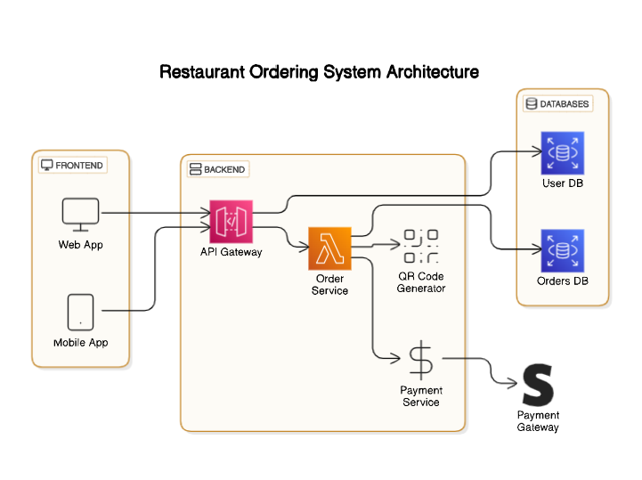
ARCHITECTURE DIAGRAM

Slide 10
MODULES
Order Management
Order Placement: Facilitates seamless order entry via mobile devices or web interfaces,
allowing customers to place orders before arriving at the restaurant.
Order Tracking: Provides real-time updates on order status for both customers and kitchen
staff, enhancing communication and transparency.
QR Code Generation: Generates unique QR codes containing order details and billing
information, simplifying the payment process.
Menu Management
Dynamic Menu Display: ensuring customers have access to the latest offerings.
Customization Options: Enables customers to tailor their orders according to preferences and
dietary restrictions, improving satisfaction.
Payment Processing
Multiple Payment Methods: Supports a variety of payment options, including credit/debit cards and making transactions convenient for customers.
Secure Transactions: Ensures the secure handling of payment information through integration with payment gateways.

Slide 11
SRS FUNCTIONAL REQUIREMENTS
Functional Requirements for Quickbite Software includes the ability for customers to modify or cancel the orders. with approval from head chef and system to assign dishes to specific chefs in order queue. It helps in pre-ordering the food using the menu in website. After ordering the food, an unique QR Code will be displayed. Then the customer can use the QR Code to order , add more foods and settle the bill using the same code.

Slide 12
SRS NON FUNCTIONAL REQUIREMENTS
Non Functional Requirements for Quickbite software focuses on performance , safety, security and software quality attributes like User Friendliness, and other options. Where security is encrypted with login authentication. Unique QR code will be generated to customers as it avoids clashing of same orders. Discounts are provided on certain days to engage customers also attracting more customers to the website.

Slide 13
SOFTWARE MODEL: AGILE MODEL
Adaptability to Changing Requirements: An online ordering system may require frequent updates to meet customer needs, adapt to trends, and add features like online payments, menu updates, or special promotions. Agile’s iterative sprints allow for incremental changes, making it easier to adapt.
Frequent User Feedback: Agile's focus on continuous user involvement means that you can get feedback from potential users, restaurant owners, and other stakeholders during each sprint. This ensures that the system evolves based on real user needs.
Rapid Deployment: Agile encourages frequent releases, allowing you to deploy a Minimum Viable Product (MVP) with core functionalities and gradually build out new features. This approach helps get the product to market faster and adjust based on user interaction.
Improved Collaboration: If you’re working with a team, Agile’s structured communication and sprint planning enhance collaboration, making it easy to integrate inputs from different developers, designers, and testers.

Slide 14
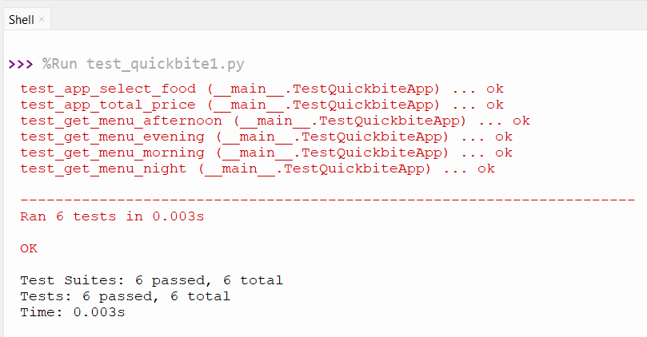
TESTING
UNIT TESTING:
Unit testing is a software testing method where individual components or units of a program are tested independently to ensure that each one functions correctly.

Slide 15
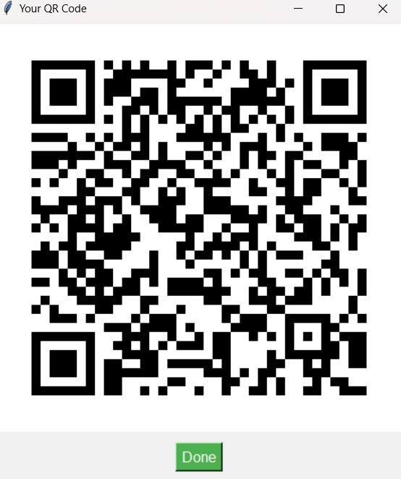
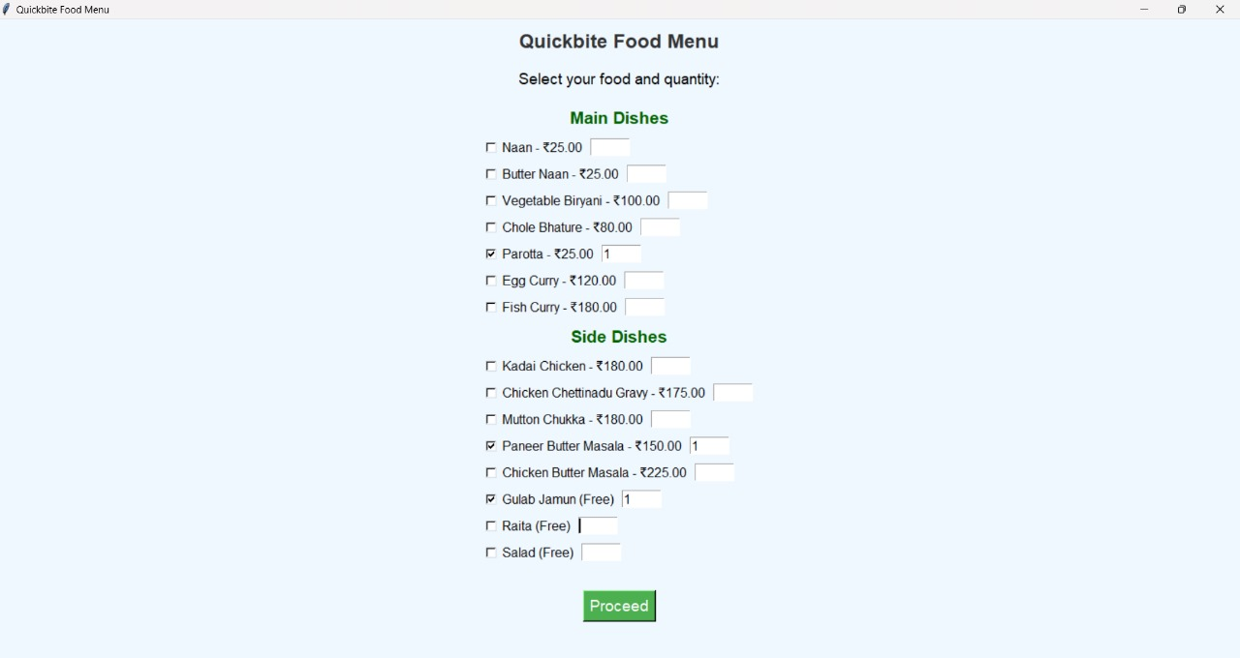
OUTPUT

Slide 16
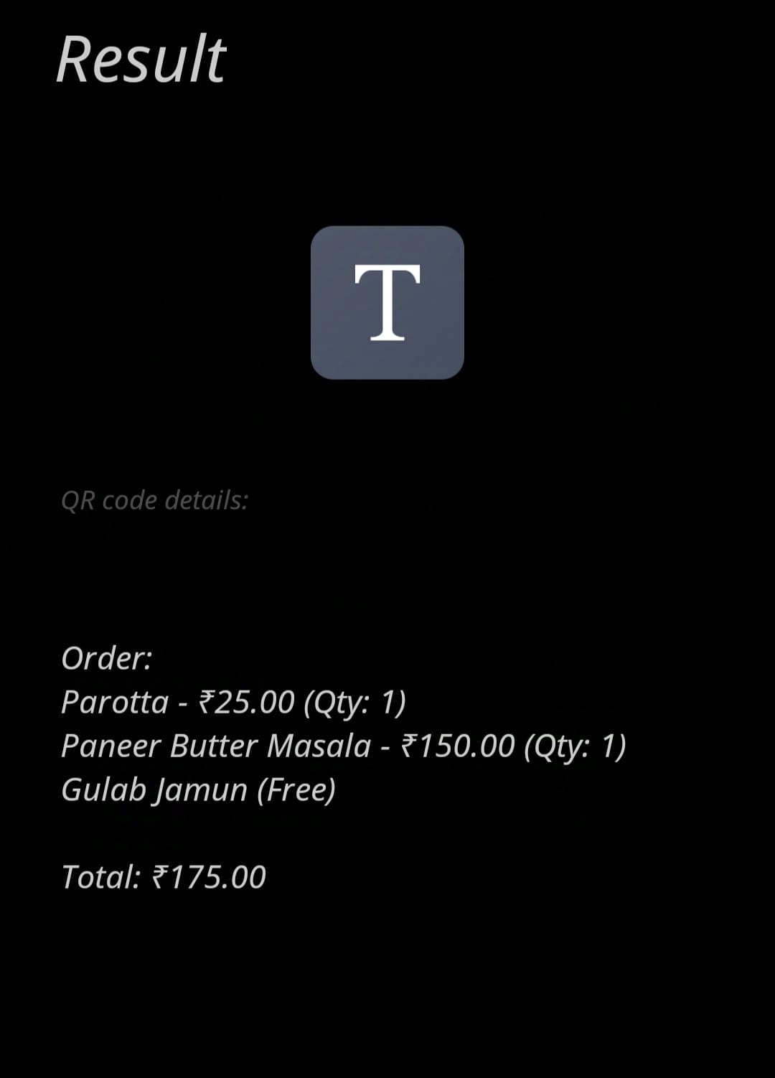
OUTPUT

Slide 17
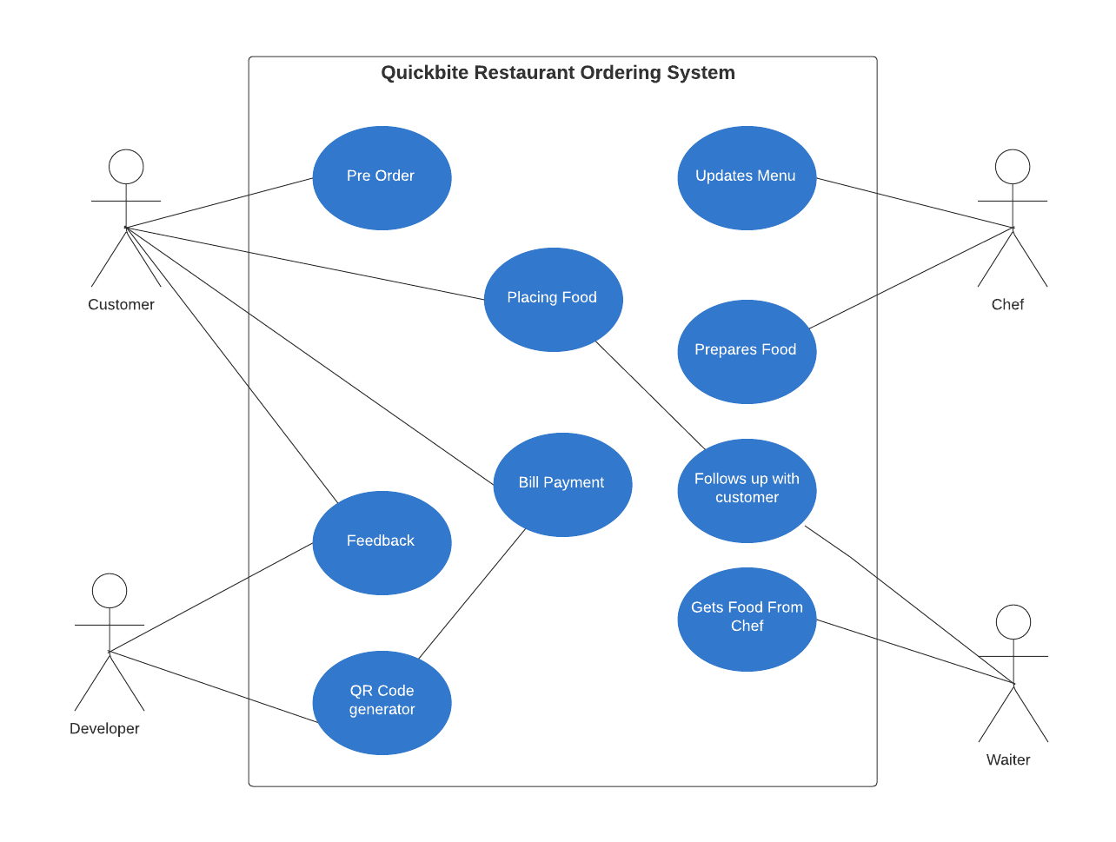
USE CASE DIAGRAM

Slide 18
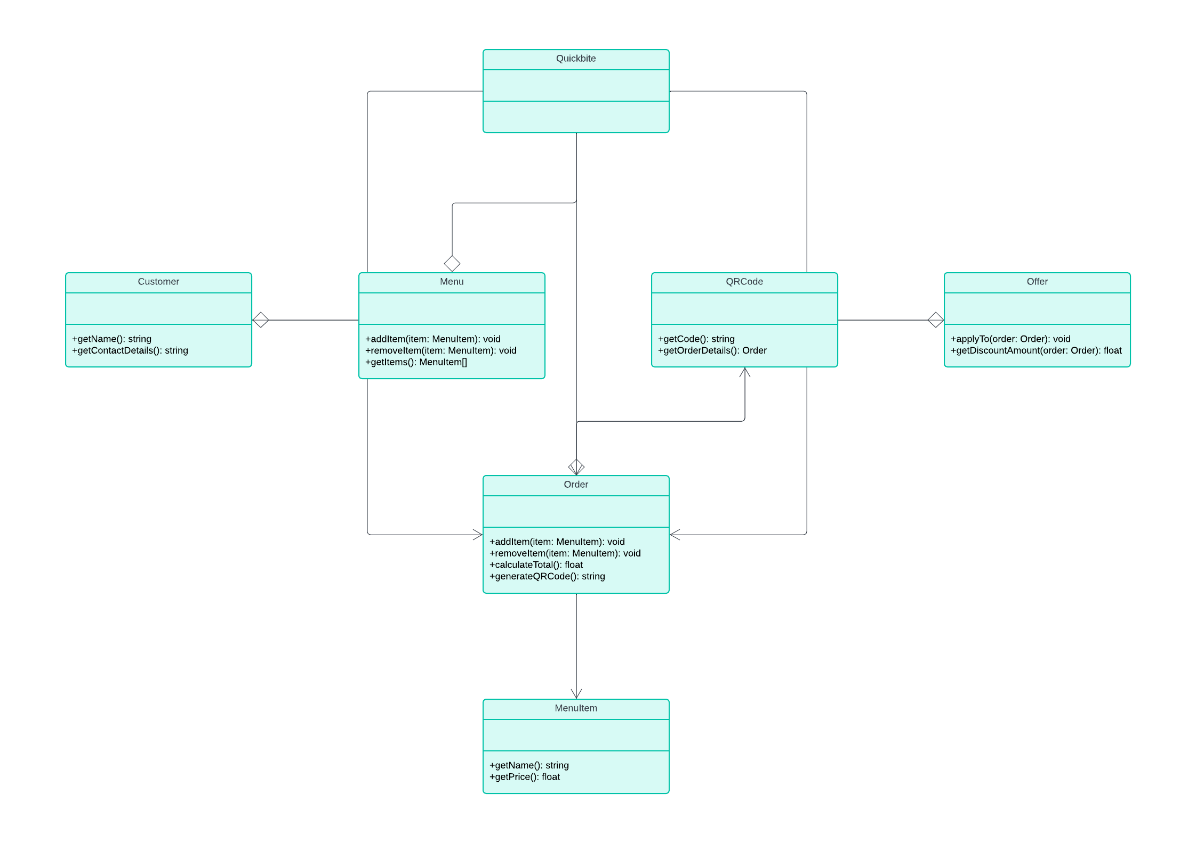
CLASS DIAGRAM

Slide 19
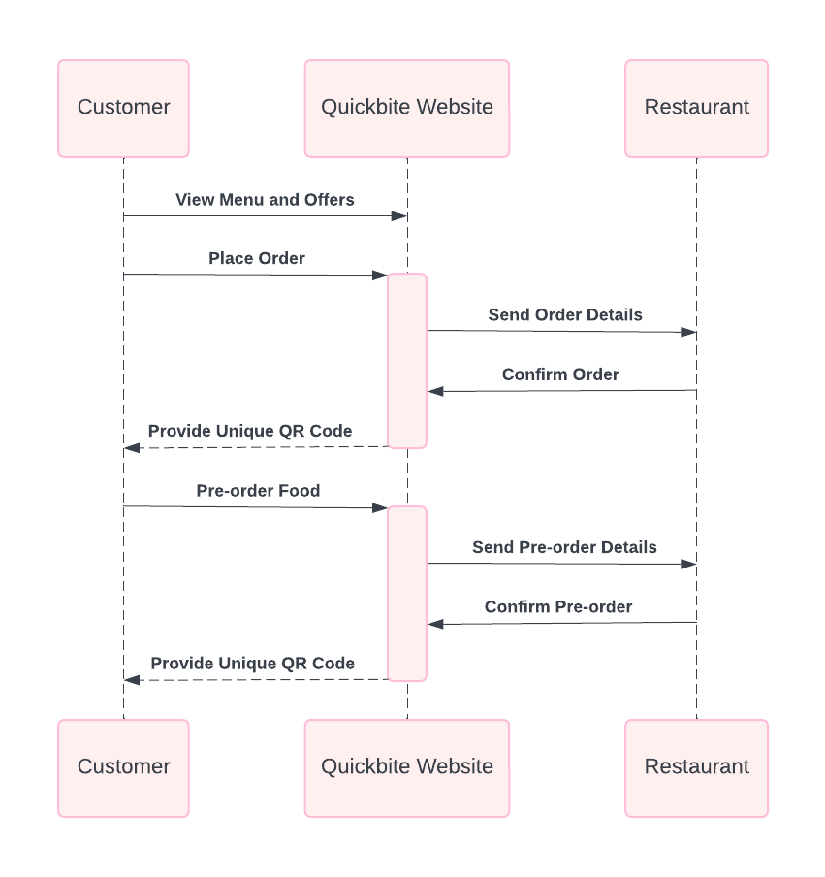
SEQUENCE DIAGRAM

Slide 20
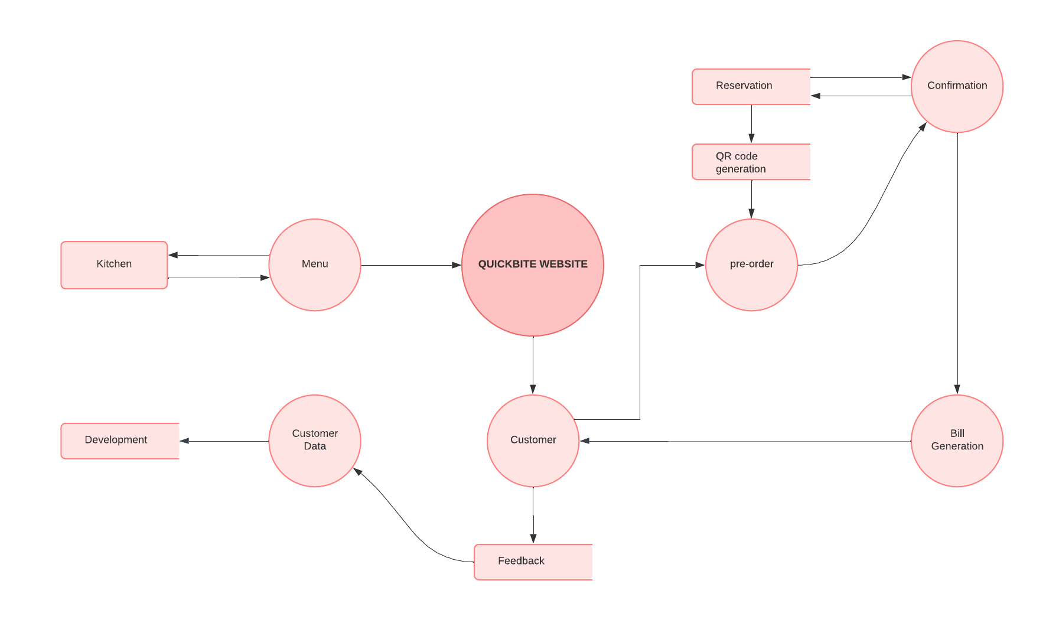
DATA FLOW DIAGRAM

Slide 21
FUTURE SCOPE
AI-Powered Personalized Recommendations
Real-Time Order Status and Updates
More functionality in QR Codes
Advanced Analytics for Restaurant Insights

Slide 22
CONCLUSION
The Quickbite Restaurant Ordering System offers an efficient and streamlined solution for managing orders, pre-orders, and menu browsing, making the ordering process faster and more convenient for customers. By providing a user-friendly interface and unique QR codes for each order, Quickbite enhances the customer experience, ensuring quick confirmations, which is especially valuable in a contactless service environment. The system also improves operational efficiency, and reducing wait times and order errors. Overall, Quickbite is a modern and robust digital solution for restaurant management, improving both customer satisfaction and internal operations in today’s fast-paced dining industry.

Slide 23
REFERENCES
1. S. Gupta, R. Sharma, and A. Joshi, "Foody - Smart Restaurant Management and Ordering System," in IEEE International Conference on Advanced Computing andCommunication Technologies (ICACCT), Kurukshetra, India, 2018, pp. 42-47.
2. P. V. Tiwari and R. K. Verma, "Netfood: A Software System for Food Ordering and Delivery," IEEE Conference on Innovations in Power and Advanced ComputingTechnologies (i-PACT), Vellore, India, 2019, pp. 263-267.
3. A. K. Yadav, S. Khanna, and N. Thakur, "Design and Implementation of a Smart Restaurant Menu Ordering System Using WiFi and RFID Technology," in Proceedings of the IEEE International Conference on Inventive Computing and Informatics (ICICI)

Slide 24
REFERENCES
4. H. Lee and J. Kim, "Automated Food Ordering System with Interactive User Interface Approach," in IEEE International Conference on System Science and Engineering (ICSSE), Pusan, South Korea, 2010, pp. 23-27.
5. A. N. Kaur and M. Singh, "A Customizable Wireless Food Ordering System with Realtime Customer Feedback," in IEEE Conference on Wireless Communication and Sensor Networks (WCSN), Lucknow, India,2011,pp.55-59.
6. M. Chen, L. Tan, and Y. Lin, "IoT-Based Restaurant Menu Ordering System using Arduino UNO," in IEEE Symposium on Internet of Things (IOT), Manila, Philippines, 2023, pp. 87-91.

Slide 25
Thank You

